Slide 1


Intro to Apache Spark™
By: Robert Sanders

Slide 2

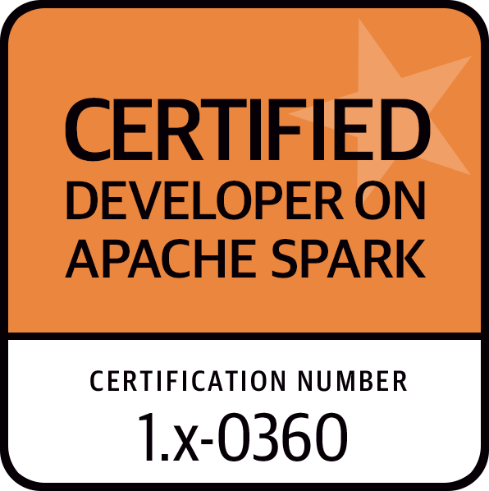
Robert Sanders
Big Data Engineer
4+ Years of Big Data Experience
Certified Apache Spark Developer
Email: robert.sanders@clairvoyantsoft.com
LinkedIn: https://www.linkedin.com/pub/robert-sanders/32/467/614

Slide 3
Workshop Objectives
Introduce the Apache Spark EcoSystem
Why Apache Spark?
Compare MapReduce to Apache Spark
Performance
Provide an in depth look at Core Apache Spark
Implementation
RDD’s
API’s
Fault Tolerance
Scheduler
Give you experience with Apache Spark through examples and exercises

Slide 4
Background of people at Workshop
Notes:
Familiar with Hadoop?
Languages Used? (java, python, scala, r)

Slide 5
History of Apache Spark
Initially started by Matei Zaharia at UC Berkeley AMPLab in 2009
Version 1 finished and open sourced in 2010 under a BSD license
RDD White paper was released
http://www.eecs.berkeley.edu/Pubs/TechRpts/2011/EECS-2011-82.pdf
In 2013, the project was donated to the Apache Software Foundation and switched its license to Apache 2.0
In February 2014, Spark became a Top-Level Apache Project
In November 2014, the engineering team at Databricks used Spark and set a new world record in large scale sorting
Databricks is a company that was founded by the creators of Apache Spark

Slide 6
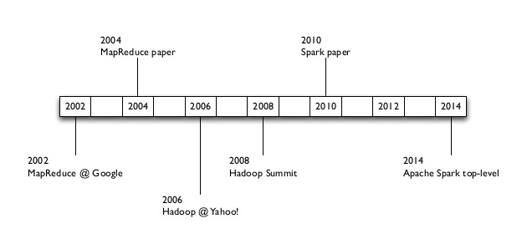
History of Apache Spark (Timeline)
Paco Nathan, O'Reilly Learning, A Brief History: Functional Programming for Big Data
http://image.slidesharecdn.com/icmesparktalk-141028221244-conversion-gate02/95/brief-intro-to-apache-spark-stanford-icme-13-638.jpg?cb=1414534463

Slide 7
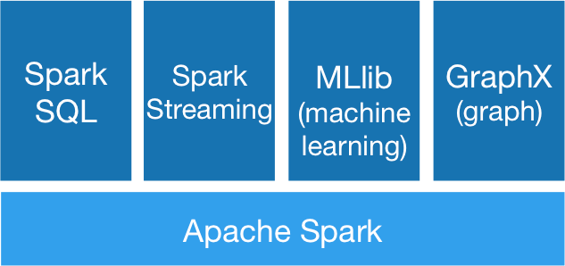
Apache Spark EcoSystem
Spark SQL
Shark
For SQL and unstructured data processing
Spark Streaming
Processing of live data streams
MLlib
Machine Learning Algorithms
GraphX
Graph Processing
Apache Spark, Apache Spark Ecosystem
http://spark.apache.org/images/spark-stack.png

Slide 8
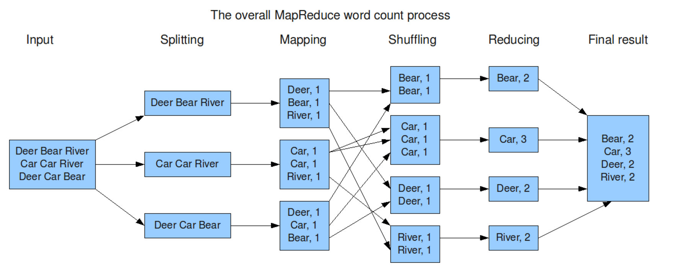
MapReduce
Michele Usuelli, Example of MapReduce
http://xiaochongzhang.me/blog/wp-content/uploads/2013/05/MapReduce_Work_Structure.png

Slide 9
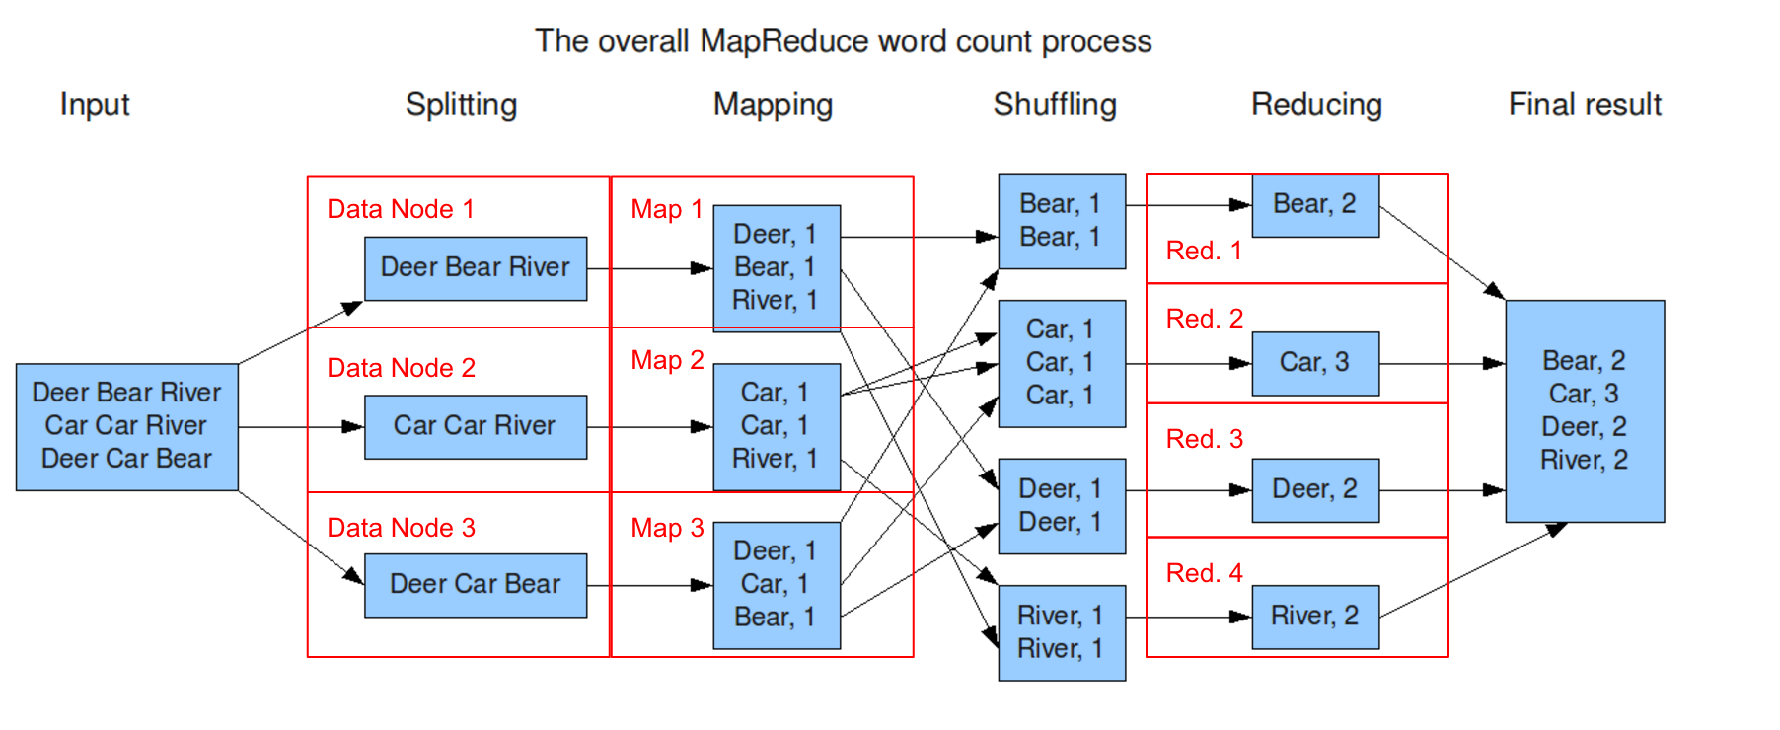
MapReduce (Hadoop)
Michele Usuelli, Example of MapReduce
http://xiaochongzhang.me/blog/wp-content/uploads/2013/05/MapReduce_Work_Structure.png
Notes:
MapReduce Fault Tolerance - Videos of early days of mapreduce Jeff Dean 2011 - deployed an app in prod and found the jobs to be running slower. they called down to the data center and found out that the data center was powering down machines, swapping out hardware (racks) and powering them back on and the job still completed but just slower.

Slide 10
Problems with MapReduce
MapReduce use cases showed two major limitations
Difficulty of programming directly in MapReduce
Performance bottlenecks, or batch not fitting the use cases
Trying to be real time
People often create specialized systems to avoid using MapReduce

Slide 11
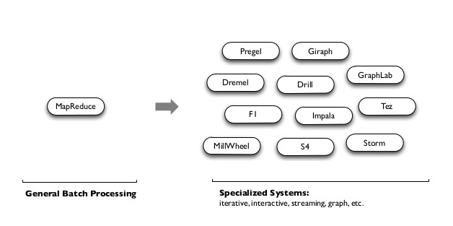
Problems with MapReduce (Specialized Systems)
Reynold Xin, Working at Databricks, Specialized Systems
http://image.slidesharecdn.com/2015-05-18cs347-stanford-150519052758-lva1-app6891/95/stanford-cs347-guest-lecture-apache-spark-13-638.jpg?cb=1432013408

Slide 12
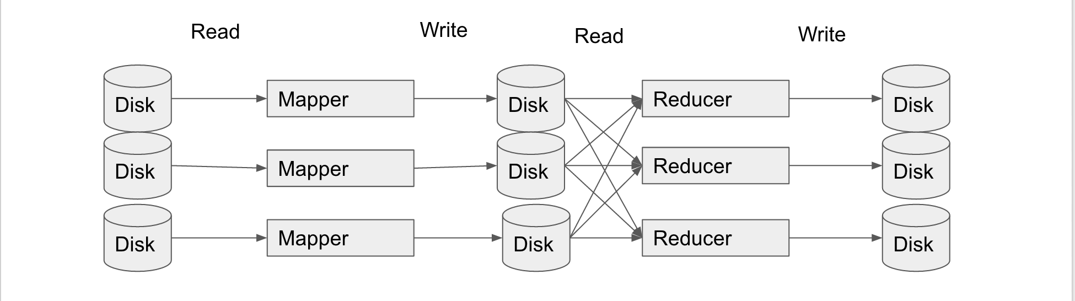
MapReduce Performance Bottlenecks
MapReduce is a very I/O heavy operation
Map phase needs to read from disk then write back out
Reduce phase needs to read from disk and then write back out

Slide 13
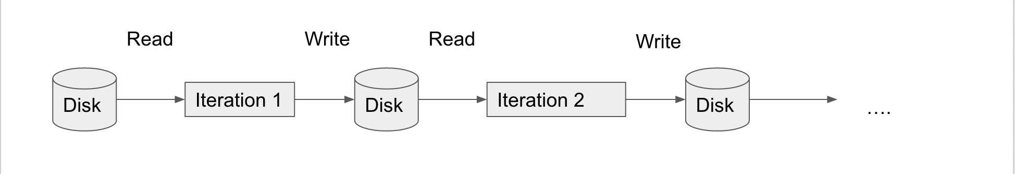
MapReduce Performance Bottlenecks (Cont.)
We often don’t just use one job. Many times we are running jobs back to back.

Slide 14
Tech Trends
Compared to where we were at when Hadoop was first around:
We now have SSD’s
Networking has improved
RAM is becoming very cheap and abundant

Slide 15
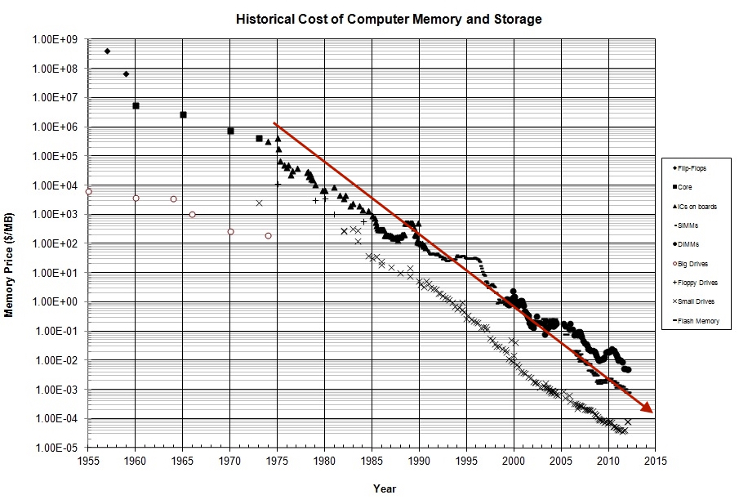
Tech Trends (RAM)
John C. McCallum, Historical cost of computer memory and storage
http://www.jcmit.com/MemoryDiskPriceGraph-2012Feb.jpg
Notes:
Log Linear plot: Dropping exponentially.
2010 = 1 cent per megabyte
Moore’s Law

Slide 16
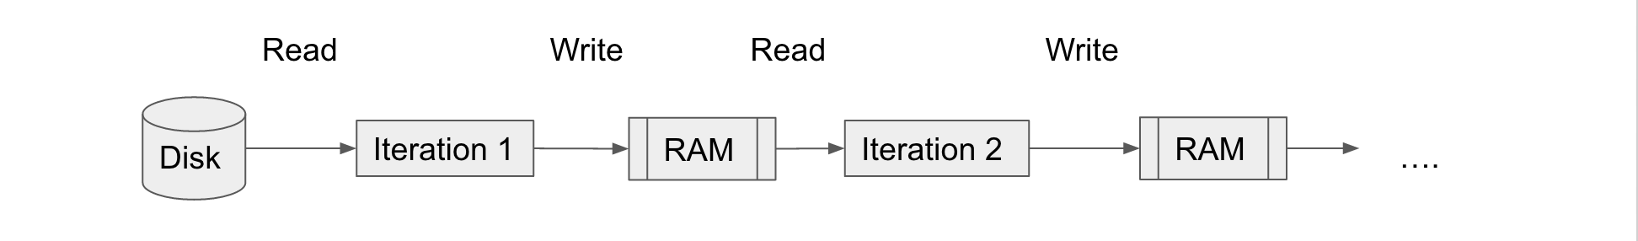
How can MapReduce be improved?
Use RAM for in-data sharing

Slide 17
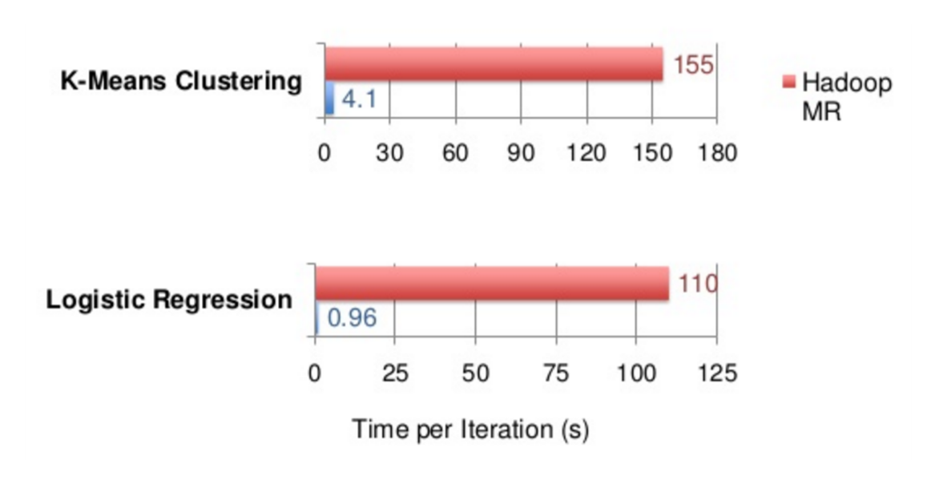
MapReduce vs Spark (Performance)
Reynold Xin, Working at Databricks, LR/K-Means Performance
http://image.slidesharecdn.com/2015-05-18cs347-stanford-150519052758-lva1-app6891/95/stanford-cs347-guest-lecture-apache-spark-52-638.jpg?cb=1432013408

Slide 18
MapReduce vs Spark (Performance) (Cont.)
Dayton Gray 100 TB sorting results
https://databricks.com/blog/2014/10/10/spark-petabyte-sort.html
 | MapReduce Record | Spark Record | Spark Record 1PB
Data Size | 102.5 TB | 100 TB | 1000 TB
# Nodes | 2100 | 206 | 190
# Cores | 50400 physical | 6592 virtualized | 6080 virtualized
Elapsed Time | 72 mins | 23 mins | 234 mins
Sort rate | 1.42 TB/min | 4.27 TB/min | 4.27 TB/min
Sort rate/node | 0.67 GB/min | 20.7 GB/min | 22.5 GB/min
Notes:
Since Spark won, TritonSort has beaten the old record

Slide 19
MapReduce vs Spark (Implementation)
 | MapReduce | Spark
Storage | Disk Only | In Memory and Disk
Operations | MapReduce | Map, Reduce, Joins, Sample, etc
Execution Model | Batch | Batch, Streaming, Interactive
Programming Environment | Java | Java, Python, Scala
Notes:
Key Points
Handles batch, interactive and real-time within a single framework
Native integration with Java, Python, Scala
Programming at a higher level of abstraction
More general: map/reduce is just one set of supported constructs

Slide 20
When not to use Apache Spark
Apache Spark is best suited for applications that perform bulk transformations that apply the same operation to all the elements of a dataset.
Apache Spark would be less suitable for applications that make asynchronous fine-grained updates to shared state
Storage system for a web applications or an incremental web crawler and indexer.

Slide 21
Is Spark a replacement for MapReduce?

Slide 22
VM Installation and Setup
Directions available in “Setup and Exercises” Document
Notes:
Setup the environment with them
Run through and make sure everything is working
Introduce Dev Folders and locations

Slide 23
Running Spark Jobs
Shell
Shell for running Scala Code
$ spark-shell
Shell for running Python Code
$ pyspark
Submitting
$ spark-submit --class {MAIN_CLASS} [OPTIONS] {PATH_TO_FILE} {ARG0} {ARG1} … {ARGN}

Slide 24

Spark Drivers and Workers
Apache Spark, Cluster Mode Overview
http://spark.apache.org/docs/latest/img/cluster-overview.png

Slide 25
SparkContext
A Spark program first creates a SparkContext object
Spark Shell automatically creates a SparkContext as the sc variable
Tells spark how and where to access a cluster
Use SparkContext to create RDDs
Documentation
https://spark.apache.org/docs/latest/api/scala/index.html#org.apache.spark.SparkContext

Slide 26
SparkContext (Creation)
Python
from pyspark import SparkConf, SparkContext
conf = SparkConf().setMaster("local").setAppName("My App")
sc = SparkContext(conf = conf)
Scala
import org.apache.spark.SparkConf
import org.apache.spark.SparkContext
import org.apache.spark.SparkContext._
val conf = new SparkConf().setMaster("local").setAppName("My App")
val sc = new SparkContext(conf)
Java
import org.apache.spark.SparkConf;
import org.apache.spark.api.Java.JavaSparkContext;
SparkConf conf = new SparkConf().setMaster("local").setAppName("My App");
JavaSparkContext sc = new JavaSparkContext(conf);

Slide 27
Cluster vs Local
The master parameter for the SparkContext determines which type and size of cluster to use.
Default: Determined by spark configurations
Value | Description
local | Run locally (one worker)
local[k] | Run locally (k workers)
local[*] | Run locally with as many worker threads as logical cores
spark://{host}:{port} | Connect to spark standalone cluster
mesos://{host}:{port} | Connect to Mesos cluster
yarn-client | Connect to YARN cluster in client mode
yarn-cluster | Connect to YARN cluster in cluster mode

Slide 28
Cluster vs Local (Cont.)
How to set master:
Shell
$ spark-shell --master {YOUR-VALUE}
$ pyspark --master {YOUR-VALUE}
In Code
new SparkConf().setMaster(“{YOUR-VALUE}”)
Submitting
$ spark-submit --master {YOUR-VALUE}

Slide 29
Cluster vs Local (yarn-client vs yarn-cluster)
In yarn-client mode, the driver runs in the client process, and the application master is only used for requesting resources from YARN.
If the local process is killed it kills the job
In yarn-cluster mode, the Spark driver runs inside an application master process which is managed by YARN on the cluster.
If the local process is kill the job will still run and complete

Slide 30
RDDs
Primary abstraction object used by Apache Spark
Resilient Distributed Dataset
Fault-tolerant
Collection of elements that can be operated on in parallel
Distributed collection of data from any source
Contained in an RDD:
Set of partitions
Atomic pieces of a dataset
Set of dependencies on parent RDDs
Lineage (Directed Acyclic Graph - DAG)
A function for computing the RDD based on its parents
Metadata about its partitioning scheme and data placement

Slide 31
RDDs (Cont.)
RDDs are immutable
Allows for more effective fault tolerance
Intended to support abstract datasets while also maintain MapReduce properties like automatic fault tolerance, locality-aware scheduling and scalability.

Slide 32
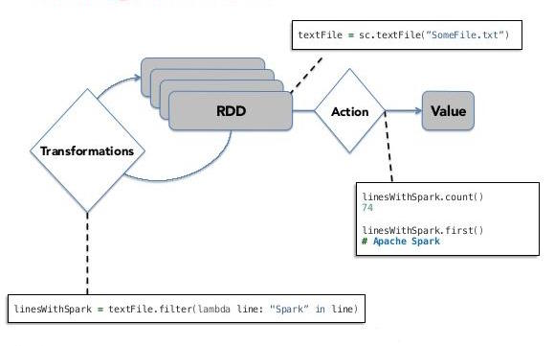
RDDs (Cont.)
Lazy Evaluation
Waits for action to be called before distributing actions to worker nodes
Surendra Pratap Singh - To The New, Working with RDDs
http://www.tothenew.com/blog/wp-content/uploads/2015/02/580x402xSpark.jpg.pagespeed.ic.KZMzgXwkwB.jpg

Slide 33
Create RDD
Can only be created using the SparkContext or by adding a Transformation to an existing RDD
Using the SparkContext:
Parallelized Collections – take an existing collection and run functions on it in parallel
rdd = sc.parallelize([ "some", "list", "to", "parallelize"], [numTasks])
File Datasets – run functions on each record of a file in Hadoop distributed file system or any other storage system supported by Hadoop
rdd = sc.textFile("/path/to/file", [numTasks])
rdd = sc.objectFile("/path/to/file", [numTasks])

Slide 34
Spark in Action (Shell)
Open shell
Execute commands
Scala
val data = 1 to 5
val dataRDD = sc.parallelize(data)
val filteredDataRDD = dataRDD.filter(_ < 3)
filteredDataRDD.collect()
Python
data = range(1,6)
dataRDD = sc.parallelize(data)
filteredDataRDD = dataRDD.filter(lambda x : x < 3)
filteredDataRDD.collect()

Slide 35
Spark in Action (Submitting)
Java
List<Integer> data = new ArrayList<Integer>() {{add(1); add(2); add(3); add(4); add(5);}};
JavaRDD<Integer> dataRDD = sc.parallelize(data);
JavaRDD<Integer> filteredDataRDD = dataRDD.filter(new Function<Integer, Boolean>() {
public Boolean call(Integer integer) throws Exception {
return integer < 3;
}
});
System.out.println(filteredDataRDD.collect());
From Command Line:
$ cd /home/cloudera/spark-workshop/spark_workshop_codebase/playground/target
$ spark-submit --class com.clairvoyant.spark_workshop.playground.java.PlaygroundJavaSparkApp com.clairvoyant.spark_workshop.playground-jar-with-dependencies.jar

Slide 36
Exercise 1 – Running Spark Jobs
See “Setup and Exercise” Document

Slide 37
Word Count Example
Scala
val textFile = sc.textFile("/path/to/file.txt")
val counts = textFile
.flatMap(line => line.split(" "))
.map(word => (word, 1))
.reduceByKey(_ + _)
counts.saveAsTextFile("/path/to/output")
Python
text_file = sc.textFile("/path/to/file.txt")
counts = text_file
.flatMap(lambda line: line.split(" "))\
.map(lambda word: (word, 1))\
.reduceByKey(lambda a, b: a + b)
counts.saveAsTextFile("/path/to/output")

Slide 38
Word Count Example (Java 7)
JavaRDD<String> textFile = sc.textFile("/path/to/file.txt");
JavaRDD<String> words = textFile.flatMap(new FlatMapFunction<String, String>() {
public Iterable<String> call(String line) {
return Arrays.asList(line.split(" "));
}
});
JavaPairRDD<String, Integer> pairs = words.mapToPair(new PairFunction<String, String, Integer>() {
public Tuple2<String, Integer> call(String word) {
return new Tuple2<String, Integer>(word, 1);
}
});
JavaPairRDD<String, Integer> counts = pairs.reduceByKey(new Function2<Integer, Integer, Integer>() {
public Integer call(Integer a, Integer b) {
return a + b;
}
});
counts.saveAsTextFile("/path/to/output");
Notes:
Talk more about how to execute functions in Java
Types have to be defined with java whereas they are inferred in python and scala

Slide 39
Java Versions
Java 7
JavaRDD distFile = sc.textFile("README.md");
JavaRDD words = distFile.flatMap( new FlatMapFunction() {
public Iterable call(String line) {
return Arrays.asList(line.split(" "));
}
});
Java 8
JavaRDD distFile = sc.textFile("README.md");
JavaRDD words = distFile.flatMap(line -> Arrays.asList(line.split(" ")));

Slide 40
API (Documentation)
General Documentation
https://spark.apache.org/docs/latest/api/scala/index.html
RDD Documentation
https://spark.apache.org/docs/latest/api/scala/index.html#org.apache.spark.rdd.RDD
Configuration Documentation
https://spark.apache.org/docs/latest/configuration.html

Slide 41
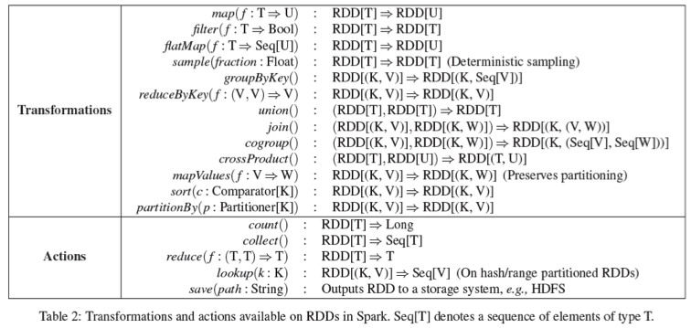
API (Overview)
Berkely.edu, Transformations and Actions
http://www.eecs.berkeley.edu/Pubs/TechRpts/2011/EECS-2011-82.pdf

Slide 42
Transformations (API)
rdd.filter(Function<T> => Boolean): RDD[T]
Return a new RDD containing only the elements that satisfy a predicate.
rdd.map(Function<T> => R): RDD[R]
Return a new RDD by applying a function to all elements of this RDD.
rdd.flatMap(Function<T> => TraversableOnce[R]): RDD[R]
Return a new RDD by first applying a function to all elements of this RDD, and then flattening the results.
rdd.reduceByKey(Function<T,T> => R): RDD[(K,R)]
When called on a dataset of (K, V) pairs, returns a dataset of (K, V) pairs where the values for each key are aggregated using the given reduce function, which must be of type (V,V) => V

Slide 43
Transformations (API) (map vs flatMap)
Contents:
Deer Bear River
Car Car River
Deer Car Bear
data.flatMap(line => line.split(" ")).collect()
//Returns:
//Array(Deer, Bear, River, Car, Car, River, Deer, Car, Bear)
data.map(line => line.split(" ")).collect()
//Returns:
//Array(Array(Deer, Bear, River), Array(Car, Car, River), Array(Deer, Car, Bear))

Slide 44
Actions (API)
rdd.count(): Long
Returns the number of elements in the RDD.
rdd.collect(): Array[T]
Returns an array that contains all of the elements in this RDD.
rdd.reduce(Function<T,T> => R): R
Reduces the elements of this RDD using the specified commutative and associative binary operator.
rdd.saveAsTextFile(“<Path>”): Unit
Save this RDD as a text file, using string representations of elements.

Slide 45
MapReduce using Spark
Basic
data.flatMap(myMap)
.groupByKey()
.map((k, v) => myReduce(k, v))
With Combiner
data.flatMap(myMap)
.reduceByKey(myCombiner)
.map((k, v) => myReduce(k, v))

Slide 46
Java RDDs
JavaRDDLike - Parent Java RDD object for all Java RDD
JavaRDD<T> - Regular RDD
JavaPairRDD<K,V> - RDD with <key, value>
JavaDoubleRDD - RDD of only Double entries
JavaHadoopRDD<K,V> - An RDD that provides core functionality for reading data stored in Hadoop (e.g., files in HDFS, sources in HBase, or S3), using the older MapReduce API (org.apache.hadoop.mapred). hadoop 1.0
JavaNewHadoopRDD<K,V> - An RDD that provides core functionality for reading data stored in Hadoop (e.g., files in HDFS, sources in HBase, or S3), using the new MapReduce API (org.apache.hadoop.mapreduce) - hadoop 2.0

Slide 47
Java RDD Functions
T - Input Type, R - Return Type, K - Key Type, V - Value Type
DoubleFlatMapFunction<T>
Returns Iteratable of Doubles
DoubleFunction<T>
Returns Double
FlatMapFunction<T,R>, FlatMapFunction2<T1,T2,R>
Returns Iteratable of type R
Function0<R>, Function<T, R>, Function2<T1,T2,R>, Function3<T1,T2,T3,R>
Returns value of type R
PairFlatMapFunction<T,K,V>
Returns Iteratable of Tuple with type <K,V>
PairFunction<T,K,V>
Returns single Tuple with type <K,V>
VoidFunction<T>
Returns void

Slide 48
Java RDD Functions (Cont.)
flatMap
JavaRDD<String> outputData = data.flatMap(new FlatMapFunction<String, String>() {
public Iterable<String> call(String s) throws Exception {
return Arrays.asList(s.split(“ “));
}
});
Map
JavaRDD<String> outputData = data.map(new Function<String, String>() {
public String call(String s) throws Exception {
return s.trim();
}
});

Slide 49
Creating PairRDDs
Scala
rdd.map(key => (key,“value”))
Python
rdd.map(lambda key: (key,“value”))
Java
rdd.mapToPair(new PairFunction<String, String, String>() {
public Tuple2<String, String> call(String key) {
return new Tuple2<String, String>(key, “value”);
}
});

Slide 50
Accessing Tuple Attributes
Scala
pairRDD.foreach(tuple => {
val key = tuple._1
val value = tuple._2
})
Python
pairRDD.foreach(lambda tuple:
key = tuple[0]
value = tuple[1]
)
Java
pairRDD.foreach(new VoidFunction<Tuple2<String, Integer>>() { public void call(Tuple2<String, Integer> tuple) { String key = tuple._1(); Integer value = tuple._2(); } });

Slide 51
Exercise 2 – Access Logs
See “Setup and Exercise” Document

Slide 52
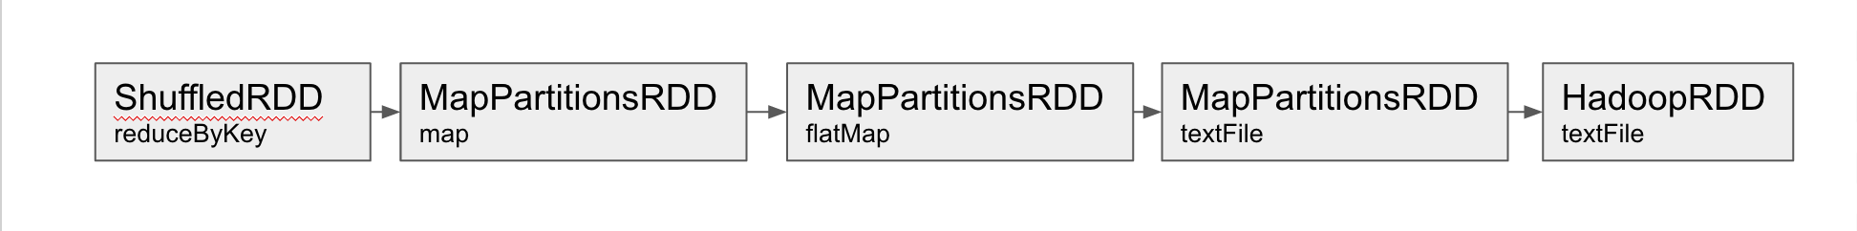
RDD Lineage Graph
val textFile = spark.textFile("/path/to/file.txt")
val counts = textFile.flatMap(line => line.split(" "))
.map(word => (word, 1))
.reduceByKey(_ + _)
counts.toDebugString
res1: String =
(1) ShuffledRDD[7] at reduceByKey at <console>:23 []
+-(1) MapPartitionsRDD[6] at map at <console>:23 []
| MapPartitionsRDD[5] at flatMap at <console>:23 []
| /path/to/file.txt MapPartitionsRDD[3] at textFile at <console>:21 []
| /path/to/file.txt HadoopRDD[2] at textFile at <console>:21 []

Slide 53
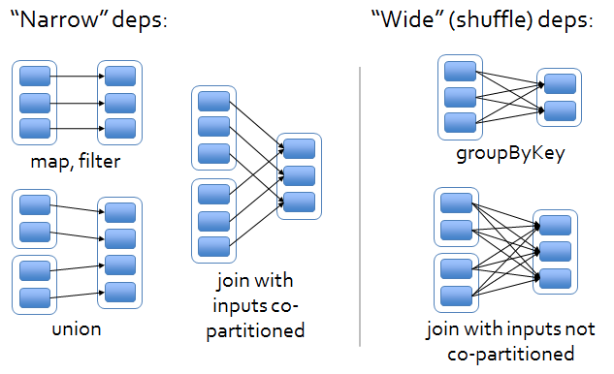
RDD Dependencies
Narrow Dependencies
Allow pipelined execution on one cluster node
Recovery after a node failure is more efficient. Only the lost parent partitions need to be recomputed which can be done in parallel on different nodes.
Wide Dependencies
Requires data from all parent partitions to be available and to be shuffled across the nodes using a MapReduce like shuffling algorithm.
A single failed node might cause the loss of a partition from all the ancestors of an RDD, requiring a complete re-execution.
Berkely.edu, RDD Dependencies
http://www.eecs.berkeley.edu/Pubs/TechRpts/2011/EECS-2011-82.pdf
Notes:
This distinction is useful for two reasons. First, narrow dependencies allow for pipelined execution on one cluster node, which can compute all the parent partitions. For example, one can apply a map followed by a filter on an element-by-element basis. In contrast, wide dependencies require data from all parent partitions to be available and to be shuffled across the nodes using a MapReduce like operation. Second, recovery after a node failure is more efficient with a narrow dependency, as only the lost parent partitions need to be recomputed, and they can be recomputed in parallel on different nodes. In contrast, in a lineage graph with wide dependencies, a single failed node might cause the loss of some partition from all the ancestors of an RDD, requiring a complete re-execution.

Slide 54
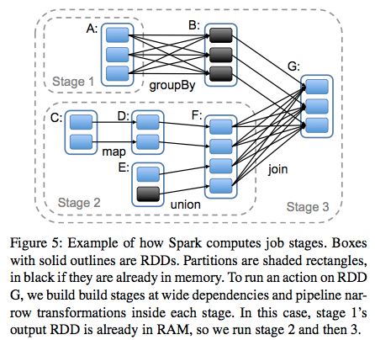
RDD Dependencies (Cont.)
Berkely.edu, RDD Dependencies
http://www.eecs.berkeley.edu/Pubs/TechRpts/2011/EECS-2011-82.pdf

Slide 55
RDD Persistence
Each node stores any partitions of it that it computes in memory and reuses them in other actions on that dataset.
After making an RDD to be persisted, the first time the dataset is computed in an action, it will be kept in memory on the nodes.
Allows future actions to be much faster (often by more than 10x) since you’re not recomputing some data every time you perform an action.
If data is too big to be cached, then it will spill to disk and memory will gradually degrade
Least Recently Used (LRU) replacement policy

Slide 56
RDD Persistence (Storage Levels)
Storage Level | MEANING
MEMORY_ONLY | Store RDD as deserialized Java objects in the JVM. If the RDD does not fit in memory, some partitions will not be cached and will be recomputed on the fly each time they're needed. This is the default level.
MEMORY_AND_DISK | Store RDD as deserialized Java objects in the JVM. If the RDD does not fit in memory, store the partitions that don't fit on disk, and read them from there when they're needed.
MEMORY_ONLY_SER | Store RDD as serialized Java objects (one byte array per partition). This is generally more space-efficient than deserialized objects, especially when using a fast serializer, but more CPU-intensive to read.
MEMORY_AND_DISK_SER | Similar to MEMORY_ONLY_SER, but spill partitions that don't fit in memory to disk instead of recomputing them on the fly each time they're needed.
DISK_ONLY | Store the RDD partitions only on disk.
MEMORY_ONLY_2, MEMORY_AND_DISK_2, etc. | Same as the levels above, but replicate each partition on two cluster nodes.

Slide 57
Persist (API)
rdd.persist()
rdd.persist(StorageLevel)
Persist this RDD with the default storage level (MEMORY_ONLY).
You can override the StorageLevel for fine grain control over persistence

Slide 58
Caching (API)
rdd.cache()
Persists the RDD with the default storage level (MEMORY_ONLY)

Slide 59
Checkpoint (API)
rdd.checkpoint()
RDD will be saved to a file inside the checkpoint directory set with SparkContext#setCheckpointDir(“/path/to/dir”)
Used for RDDs with long lineage chains with wide dependencies since it would be expensive to recompute
For now it is left to the user when to checkpoint
In the future spark will automatically checkpoint for you
Can be expensive to replicate a large amount of data
Writing data to disk

Slide 60
Unpersist (API)
rdd.unpersist()
Marks it as non-persistent and/or removes all blocks of it from memory and disk

Slide 61
Persistence Example
val textFile = sc.textFile("/path/to/file.txt")
textFile.cache()//<-Data not cached on workers yet
val counts = textFile
.flatMap(line => line.split(" "))
.map(word => (word, 1))
.reduceByKey(_ + _)
counts.collect()//<-Action executes graph which caches data

Slide 62
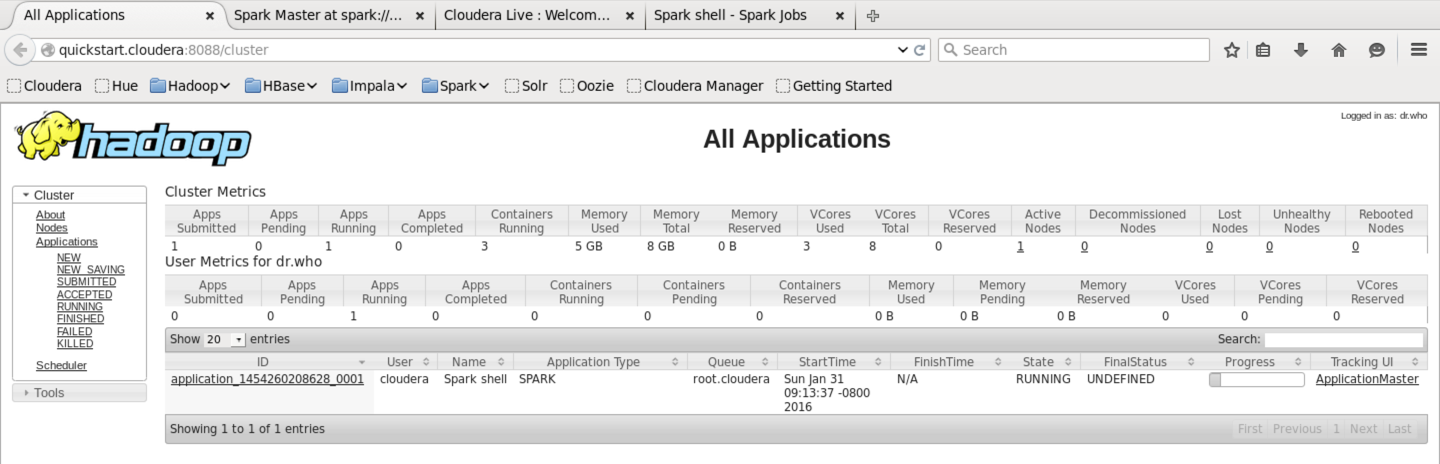
Spark UI (Resource Manager)
http://{HOST}:8088/cluster

Slide 63
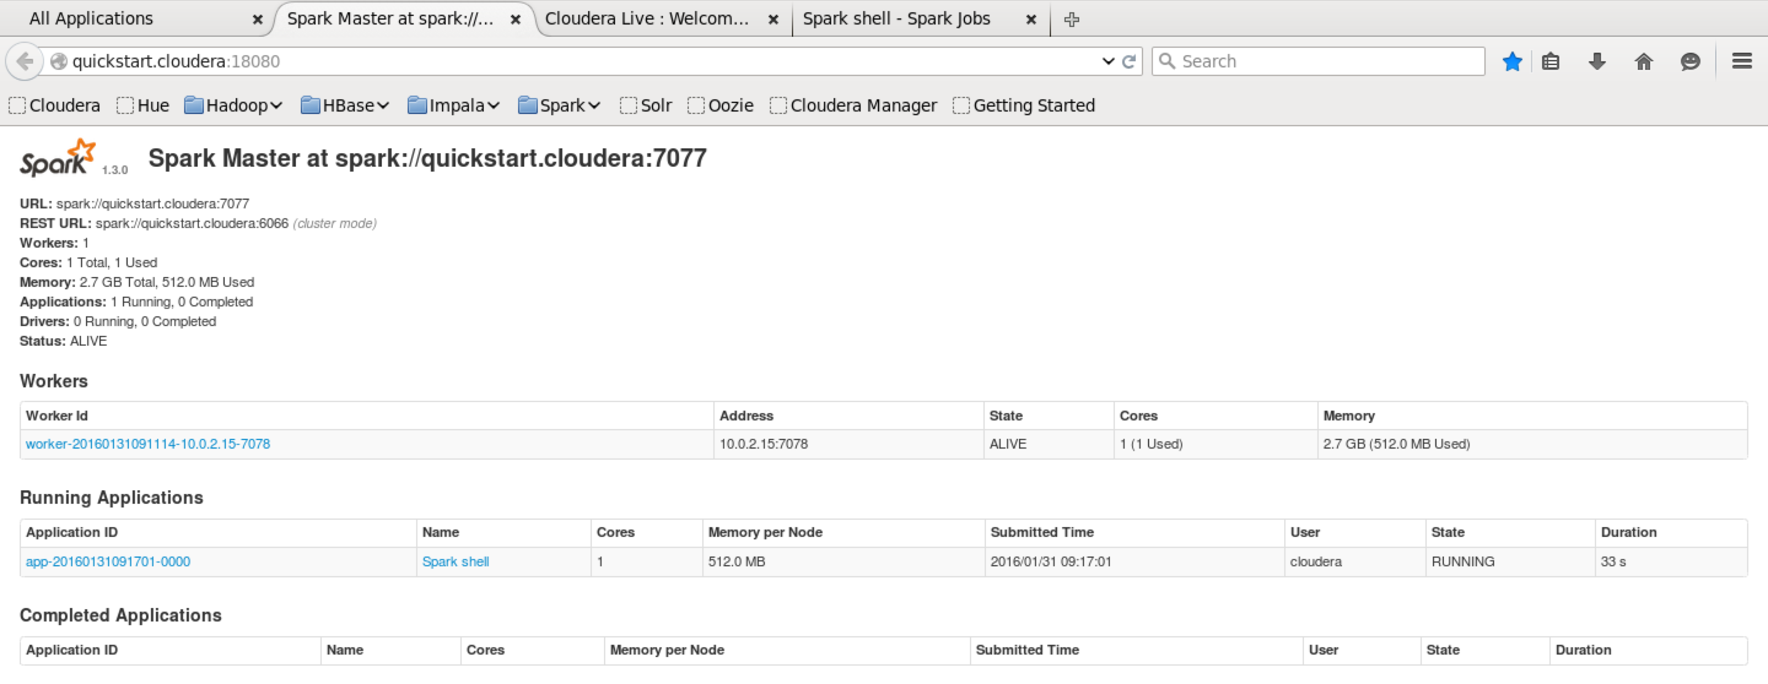
Spark UI (Spark Master)
http://{HOST}:18080

Slide 64
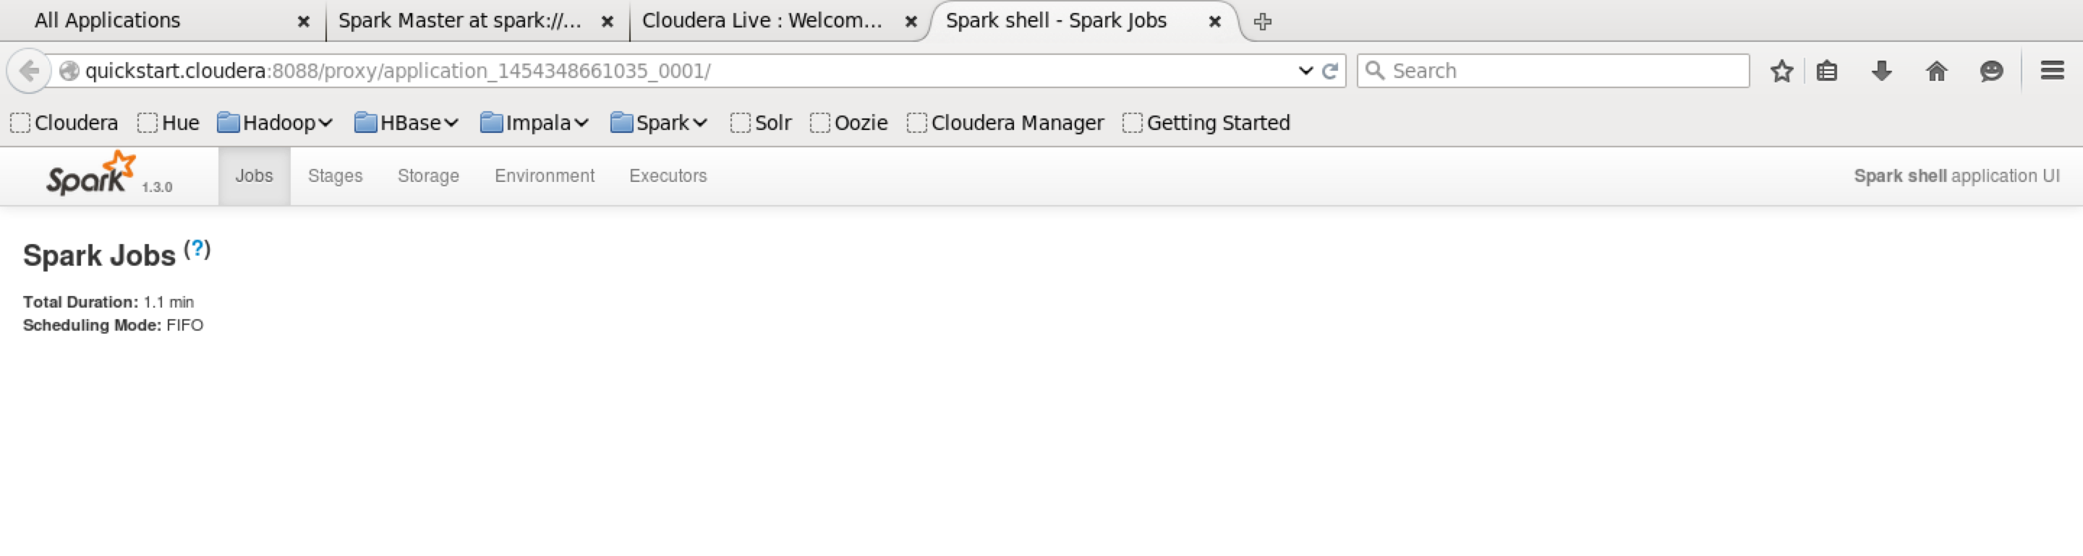
Spark UI (Spark Jobs)
http://{HOST}:8088/proxy/{APPLICATION_ID}/

Slide 65
Fault Tolerance
RDDs contain lineage graphs (coarse grained updates/transformations) to help it rebuild partitions that were lost
Only the lost partitions of an RDD need to be recomputed upon failure.
They can be recomputed in parallel on different nodes without having to roll back the entire app
Also lets a system tolerate slow nodes (stragglers) by running a backup copy of the troubled task.
Original process on straggling node will be killed when new process is complete
Cached/Check pointed partitions are also used to recompute lost partitions if available in shared memory
Notes:
Two main methods of fault tolerance: checkpointing the data or logging the updates made to it
Checkpointing is expensive on a large scale so RDDs implement logging.
Logging is through lineage
Coarse Grained vs Fine Grained
A fine grained update would be an update to one record in a database whereas coarse grained is generally functional operators (like used in spark) for example map, reduce, flatMap, join. Spark's model takes advantage of this because once it saves your small DAG of operations (small compared to the data you are processing) it can use that to recompute as long as the original data is still there. With fine grained updates you cannot recompute because saving the updates could potentially cost as much as saving the data itself, basically if you update each record out of billions separately you have to save the information to compute each update, whereas with coarse grained you can save one function that updates a billion records. Clearly though this comes at the cost of not being as flexible as a fine grained model.

Slide 66
Scheduler
Uses RDD lineage to find efficient execution plan for action
Optimizes operations by collapsing down inline narrow dependencies into one task instead of doing individual tasks for each operation
Schedules tasks based on data locality
Takes into account which RDDs are in cache
If a task needs to process a cached partition, then the task is started on the node where the data is cached
Tasks are launched to compute missing partitions

Slide 67
Joins
rdd.join(otherRDD, [numTasks]) // inner join
Requires two PairedRDDs
When called on datasets of type (K, V) and (K, W), returns a dataset of (K, (V, W)) pairs with all pairs of elements for each key.
You can create compound keys to join over more variables

Slide 68
Joins (Cont.) (Scala)
case class Register (date: String, uuid: String, cust_id: String, lat: Float, lng: Float)
case class Click (date: String, uuid: String, landing_page: Int)
val reg = sc.textFile("/user/cloudera/spark-workshop-data/join-example/reg.tsv")
.map(_.split("\t"))
.map(r => (r(1), Register(r(0), r(1), r(2), r(3).toFloat, r(4).toFloat)))
val clk = sc.textFile("/user/cloudera/spark-workshop-data/join-example/clk.tsv")
.map(_.split("\t"))
.map(c => (c(1), Click(c(0), c(1), c(2).trim.toInt)))
val joined = reg.join(clk)
joined.take(2)
//Returns: ﻿Array(
// (﻿81da510acc4111e387f3600308919594,(Register(...),Click(...))),
// (15dfb8e6cc4111e3a5bb600308919594,(Register(...),Click(...)))
// )

Slide 69
Joins (Lineage Graph)
joined.toDebugString
(2) MapPartitionsRDD[10] at join at <console>:32 []
| MapPartitionsRDD[9] at join at <console>:32 []
| CoGroupedRDD[8] at join at <console>:32 []
+-(2) MapPartitionsRDD[3] at map at <console>:25 []
| | MapPartitionsRDD[2] at map at <console>:25 []
| | /user/cloudera/spark-workshop-data/join/reg.tsv MapPartitionsRDD[1] at textFile at <console>:25 []
| | /user/cloudera/spark-workshop-data/join/reg.tsv HadoopRDD[0] at textFile at <console>:25 []
+-(2) MapPartitionsRDD[7] at map at <console>:25 []
| MapPartitionsRDD[6] at map at <console>:25 []
| /user/cloudera/spark-workshop-data/join/clk.tsv MapPartitionsRDD[5] at textFile at <console>:25 []
| /user/cloudera/spark-workshop-data/join/clk.tsv HadoopRDD[4] at textFile at <console>:25 []

Slide 70
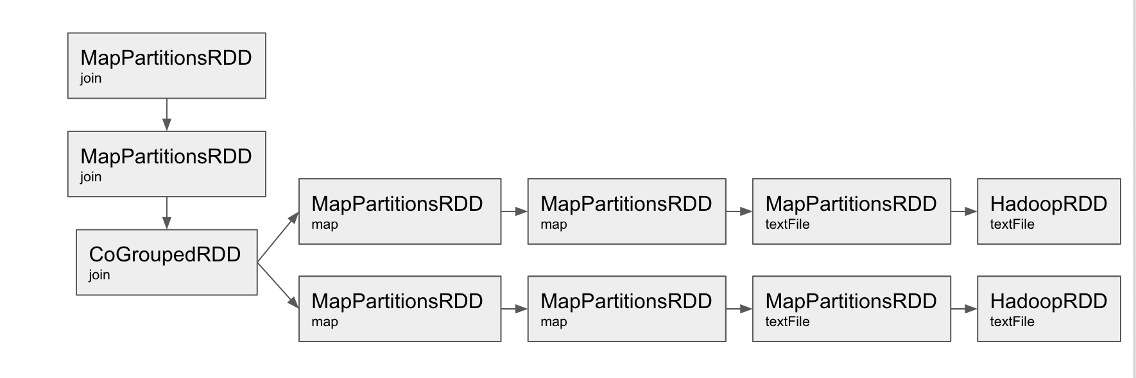
Joins (Lineage Graph) (Cont.)

Slide 71
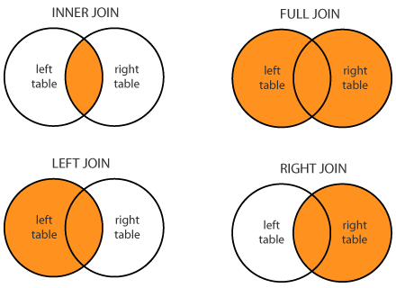
Join (Other Functions)
rdd.join(otherRDD, [numTasks]) // inner join
rdd.leftOuterJoin(otherRDD, [numTasks])
rdd.rightOuterJoin(otherRDD, [numTasks])
rdd.fullOuterJoin(otherRDD, [numTasks])
Dofactory.com, SQL Joins
http://www.dofactory.com/sql/join

Slide 72
Exercise 3 – Joining Datasets
See “Setup and Exercise” Document

Slide 73
Closures
One closure per worker
Global variables can be used by workers:
var x = 5
rdd.map( _ + x ) # Successfully add 5 to each element of an RDD
If worker tries to update global variable, the changes wont be reflected:
var counter = 0
var rdd = sc.parallelize(data)
rdd.foreach( x => counter += x ) # It won’t work!

Slide 74
Accumulators
Accumulators are variables that can only be “added” to through an associative operation
Used to implement counters and sums, efficiently in parallel
Spark natively supports accumulators of numeric value types and standard mutable collections, and programmers can extend for new types
Only the driver program can read an accumulator’s value, not the tasks

Slide 75
Accumulators (Code)
Scala
val accum = sc.accumulator(0)
rdd.foreach(entry =>
accum += 1
)
println(accum.value)
Python
accum = sc.accumulator(0)
def foreachFunction(x):
global accum
accum += x
rdd.foreach(foreachFunction)
print(accum.value)

Slide 76
Accumulators (Code) (Java)
final Accumulator accum = sc.accumulator(0);
rdd.foreach(new VoidFunction<String>() {
public void call(String entry) throws Exception {
accum.add(1);
}
});
System.out.println(accum.value());

Slide 77
Broadcast Variables
Broadcast variables let programmer keep a read-only variable cached on each machine rather than shipping a copy of it with tasks
For example, to give every node a copy of a large input dataset efficiently
Spark also attempts to distribute broadcast variables using efficient broadcast algorithms to reduce communication cost

Slide 78
Broadcast Variables (Code)
Scala
var list = List(1,2,3)
val listBroadcasted= sc.broadcast(list)
val rdd = sc.textFile("hdfs://…")
rdd.foreach( entry =>
print(listBroadcasted.value)
//Prints: List(1,2,3)
)
Python
list = [1,2,3]
listBroadcasted = sc.broadcast(list)
rdd = sc.textFile("hdfs://…")
rdd.foreach( lambda entry:
print(listBroadcasted.value)
# Prints: [1,2,3]
)

Slide 79
Broadcast Variables (Code) (Java)
final Broadcast listBroadcasted = sc.broadcast(new ArrayList<String>(){{
add(1);add(2);add(3);
}});
JavaRDD<String> rdd = sc.textFile("hdfs://…");
rdd.foreach(new VoidFunction<String>() {
public void call(String entry) throws Exception {
List<String> localList = (List)listBroadcasted.getValue();
System.out.println(localList);
// [1,2,3]
}
});

Slide 80
Exercise 4 – Shared Variables
See “Setup and Exercise” Document

Slide 81
Upcoming Spark Conferences and Events
Spark Summit East 2016
February 16th – 18th 2016 @ New York City, NY
Spark Summit 2016
June 6th - 8th 2016 @ San Francisco, CA
Spark Conference
June 6, 2015 @ Charlotte, NC

Slide 82
Certification
Certification Organizations
O’Reilly and Databricks
http://www.oreilly.com/data/sparkcert.html
Additional steps to prepare
Work with Apache Spark
Research Apache Spark Modules
SparkSQL, Spark Streaming, MLlib, Graphx
Read the RDD White Paper
Read “Learn Spark” book

Slide 83
References
https://en.wikipedia.org/wiki/Apache_Spark
http://spark.apache.org/news/spark-wins-daytona-gray-sort-100tb-benchmark.html
http://www.cs.berkeley.edu/~matei/papers/2011/tr_spark.pdf
http://training.databricks.com/workshop/itas_workshop.pdf
https://spark.apache.org/docs/latest/api/scala/index.html
https://spark.apache.org/docs/latest/programming-guide.html
https://github.com/databricks/learning-spark

Slide 84
Survey
http://svy.mk/1ntbX0Y

Slide 85
Q&A

